Slide 1

EDA on Companies Listed in AmbitionBox

Slide 2

About Me
Name: Rukmini Hatkar
Qualification: B.Com (Computers)
Experience: 5.10 years in the US Healthcare Domain as a
Senior International Claims Examiner (Non-IT)
Why I Want to Learn Data Science:
Now a days Data Science is having most demand and growth.
In this 21st Century Comparing to other fields Data science is
giving more opportunities.
Experts tells in future days Data Science is Create nearby
26 million jobs

Slide 3

Data Analysis on Companies Listed in AmbitionBox
BY
Rukmini Hatkar

Slide 4

MAIN CONTENT
Business Problem
Objective of the Project
Data Web Scraping (Collection)
Data Preprocessing
Data Visualization
Conclusion (Key Findings Overall)
Q&A Slide

Slide 5
BUSINESS PROBLEMS:
Limited Company Insights: Job seekers lack detailed info on potential employers, hindering assessment of company culture, employee experiences, and overall reputation.
Difficulty in Decision-Making:Absence of comprehensive reviews makes it hard for job seekers to make informed decisions aligning with preferences and career goals.
Time-Consuming Research:Manual efforts in researching multiple companies consume significant time, diverting focus from other job search aspects.
Lack of Transparency: Job seekers face a lack of transparency in company practices, employee satisfaction, and growth opportunities, causing uncertainty.
Risk of Uninformed Choices: Without a centralized review platform, job seekers risk uninformed choices, potentially leading to dissatisfaction or mismatched career paths.
Limited Peer Insights:Absence of platforms like AmbitionBox means job seekers miss valuable insights from peers who have experienced specific companies.

Slide 6

OBJECTIVE OF THE PROJECT
Enhance Company Insights
Streamline Decision-Making
Research Process
Improve Transparency
Centralize Review Platform
Facilitate Peer Insights

Slide 7
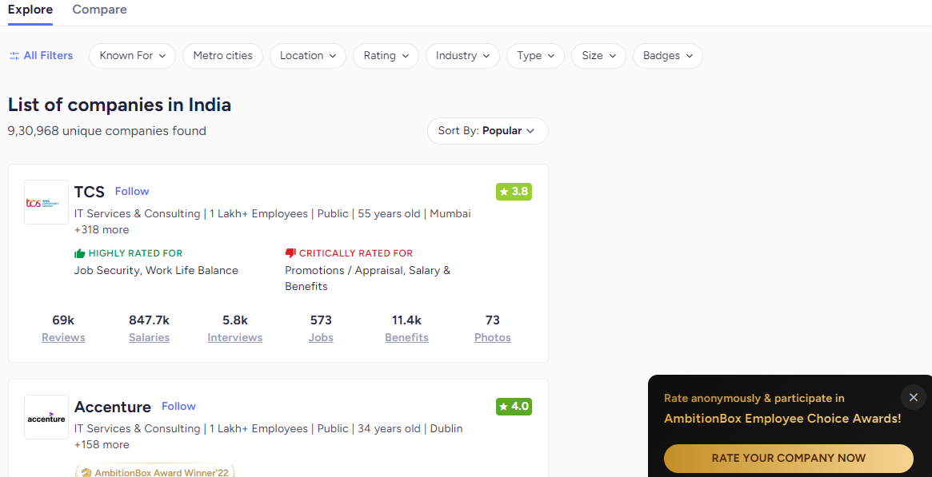
DATA WEB SCRAPPING (COLLECTION)
Website For Job Seekars Data Collection
https://www.ambitionbox.com/list-of-companies?campaign=desktop_nav&page=1
At The Place Of Page Number I Have Changed The next number For Multiple Companies
For 20 Pages

Slide 8

LIBRARIES USED FOR PROJECT:
BeautifulSoup
Numpy
Pandas
Matplotlib
Seaborn
regex

Slide 9
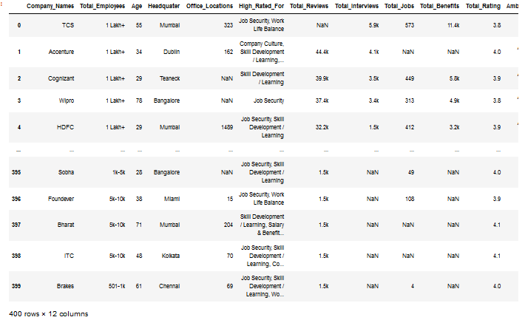
Data Collected:
Raw Data:

Slide 10
DATA CLEANING(PREPROCESSING)
Verify for duplicated entries, null values, and assess the DataFrame shape.
Utilize the info method to gather insights into column data types and missing values.
Inspect unique values in columns, calculate mean and median for numerical data.
Apply fillna (ffill) to replace missing values and use astype to standardize data types.
Transform integer values to object data types as needed.
Use the drop method to remove three columns, setting inplace=True.
Export the cleaned DataFrame to a CSV file and save it on the desktop

Slide 11
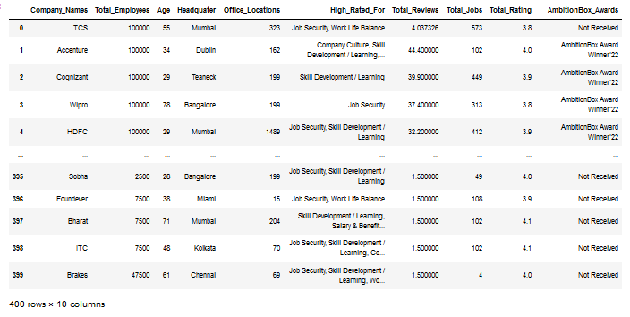
Cleaned Data:

Slide 12

LET’S START WITH VISUALISATION
UNI VARIATE BIVARIATE
MUTIVARIATE

Slide 13
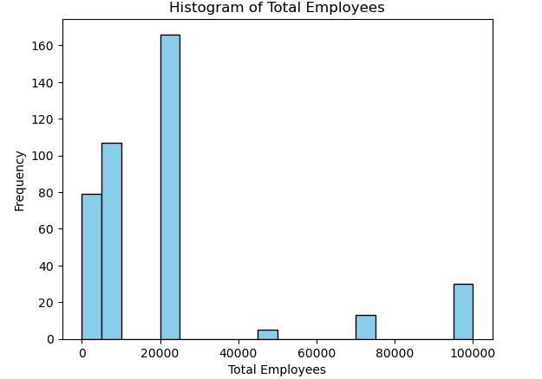
The distribution of companies based on their total number of employees.
It's indicating common employee size ranges(20 to 1lakh )among the companies

Slide 14
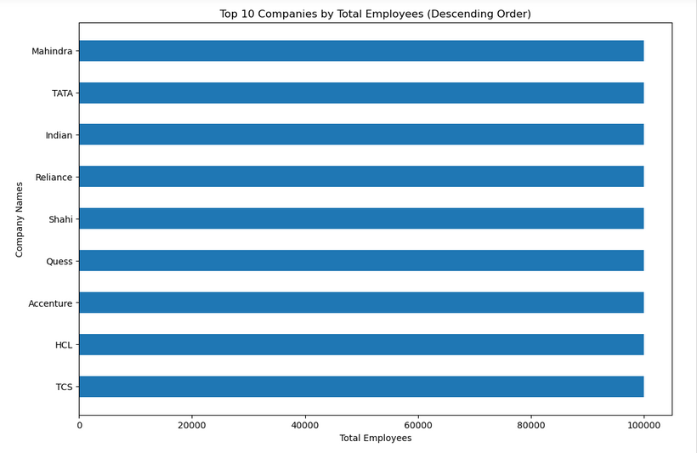
The horizontal bar chart highlights the top 10 companies with the highest number of employees 1lakh, showcasing their respective employee counts in descending order.

Slide 15
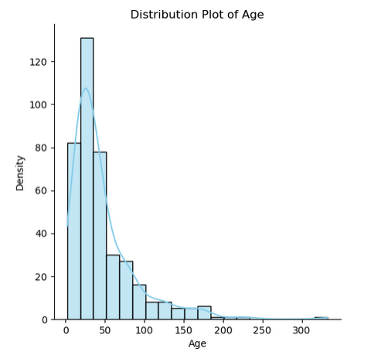
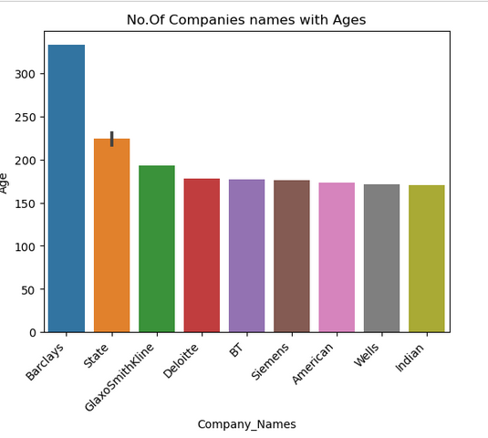
Utilizing a distribution plot, visualize the spread of company ages, highlighting the frequency of different age groups in the dataset. The age ranges from a minimum of 2 years for Kyndryl to an impressive 333 years for Barclays.
Represent the ages of the top 10 oldest companies through a bar chart based on their founding years. Remarkably, Barclays stands out as the most senior company at 333 years, while GlaxoSmithKline follows with a significant age of 193 years.

Slide 16
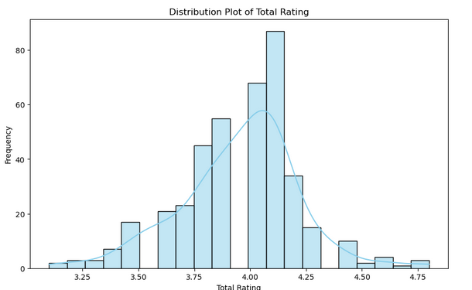
The distribution plot visually represents the frequency of total ratings given to companies, offering insights into the prevalence of specific rating values in the dataset.
plot highlight common rating ranges are between 3.75 to 4.25

Slide 17
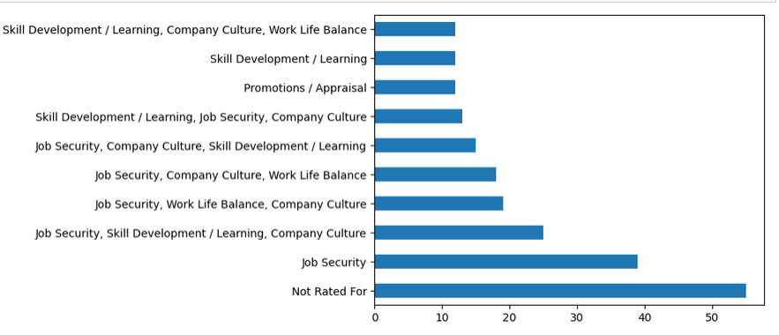
The horizontal bar chart shows what areas companies excel in, highlighting the top 10 strengths they are rated for.
Bharat, The, and Tata companies stand out for their high ratings in areas like Work-Life Balance, Company Culture, and Skill Development/Learning.

Slide 18
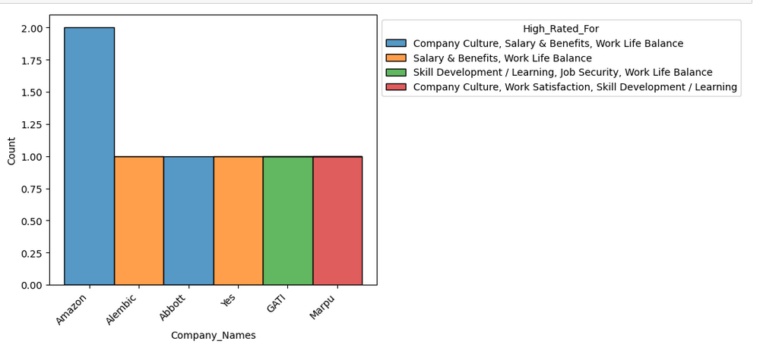
The histogram shows the count of companies with high-rated aspects, stacked by company name, offering insights into how high ratings are distributed across various categories.
Amazon stands out with high ratings in Company Culture, Salary & Benefits, and Work-Life Balance.

Slide 19
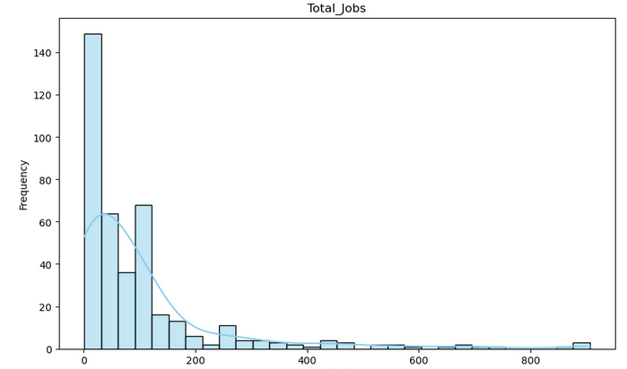
Represents The plot of 'Total_Jobs' illustrates a right-skewed distribution, indicating that a majority of observations cluster towards lower values, with a long tail extending towards higher values.
The majority of companies have job openings range under 1 to 200

Slide 20
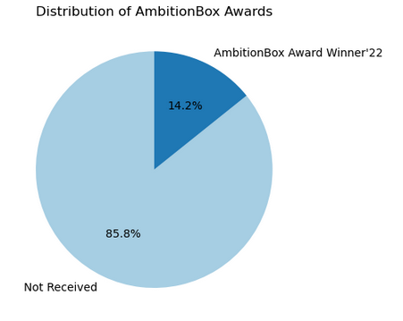
The pie chart visually represents how AmbitionBox Awards are distributed among companies, illustrating the percentage breakdown of companies with different types of awards.
Among 400 companies, only 14.2% are recognized as AmbitionBox Award Winners in 2022. Notably, Accenture, Cognizant, Wipro, ICICI, and HDFC emerge as the top 5 companies in this prestigious category

Slide 21
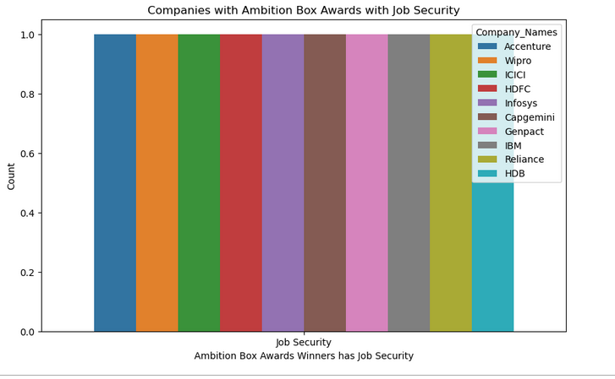
The count plot illustrates the distribution of companies that received AmbitionBox Awards, specifically focusing on those with a category related to Job Security.
Accenture,Wipro,ICICI,HDFC,Infosys,Capgemini,Genpact,IBM,Reliance,HDB companies with AmbitionBox Awards has Job Security.

Slide 22
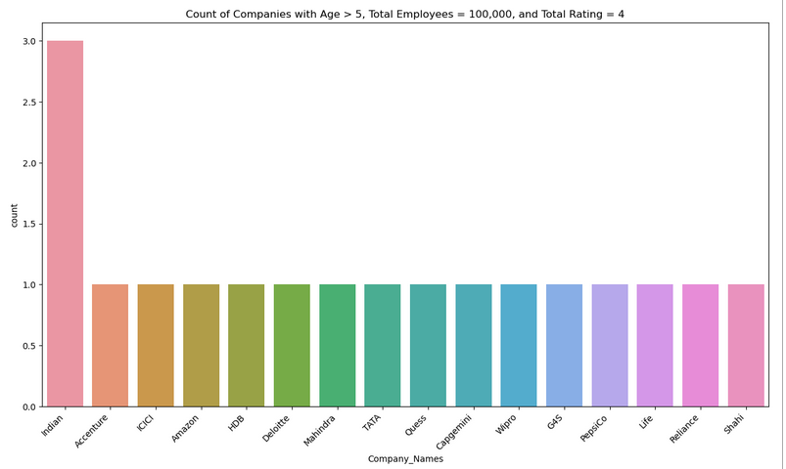
Analyzing companies with age greater than 5 years, total employees reaching 100,000, and a stellar total rating of 4.
Indian,Accenture,ICICI,Amazon,HDB,Deloitte,Mahindra,TATA,Quess,Capgemini,wipro,G45,Pepsico,life,Reliance,shahi are the companies

Slide 23
Conclusion:
Preferred Companies by Job Seekers: Accenture, Wipro, ICICI, HDFC, Infosys, Capgemini, Genpact, IBM, Reliance, and HDB are the top choices.
Companies with High Ratings: Accenture, ICICI, Amazon, IBM, Larsen, HDB, Vodafone, Deloitte, Reliance, and Bharti are highly rated by job seekers
Company Culture, Job Security, Skill Development / Learning: Accenture and Titan stand out as companies with a strong focus on company culture, job security, and skill development/learning.
Promotions / Appraisal, Salary & Benefits: Startek and eClerx are recommended for those seeking opportunities for promotions, appraisal, and competitive salary & benefits.
Companies with a Long History: Barclays, State, Deloitte, American, and BT are established companies with a significant number of years in operation.
Companies with a Large Workforce: Mahindra, TATA, Indian Reliance, Accenture, HCL, and TCS are among the companies with a substantial number of employees.
These companies provide potential job opportunities for individuals seeking a large work environment.

Slide 24


Slide 25

THANK YOU

